Slide 1



Telerik Test Studio
Desktop and Mobile Testing
Miroslav Shtilianov
QA Engineer
Automated Testing Team
Telerik QA Academy
http://qaacademy.telerik.com

Slide 2
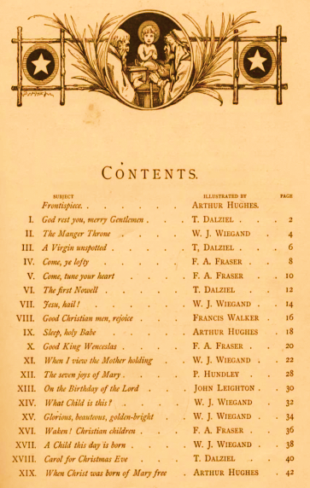


Table of Contents
Testing WPF Desktop Applications With Test Studio
Mobile Testing
Telerik Testing Framework
Test Studio’s Extras
Bug Tracking
Test Studio Explore
Visual Studio Plug in

Slide 3
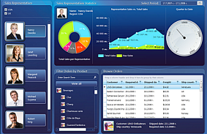
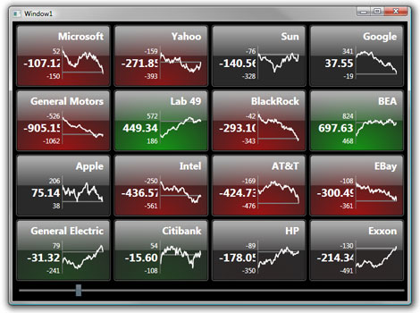
Testing WPF Desktop Applications With Test Studio

Slide 4
What is Windows Presentation Foundation?
Windows Presentation Foundation (WPF)
An entirely new graphical display system for Windows
Empowers rich-media applications
Provides a clear separation between the UI (XAML) and the business logic (C#)
Influenced by modern display technologies such as HTML, CSS and Flash
Hardware-accelerated

Slide 5
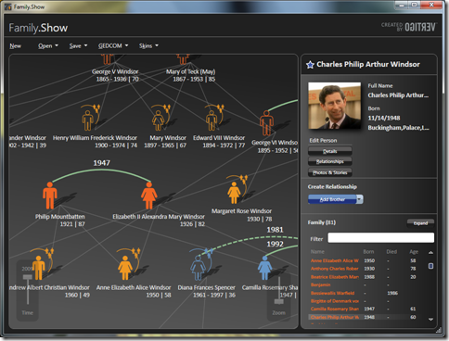
Testing WPF Desktop Applications
Demo

Slide 6


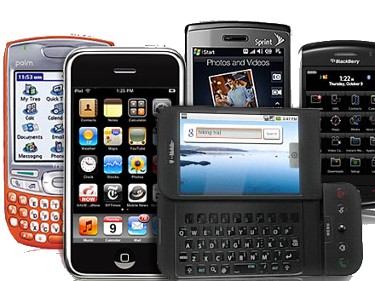
Mobile Testing
The Real Deal Mobile Testing

Slide 7

Challenges with Testing Mobile Devises
Thousands of Mobile Handsets
different screen sizes, input methods (QWERTY, touch, normal) with different hardware capabilities

Slide 8

Challenges with Testing Mobile Devises
Different Mobile Platforms/OS
mobile platforms, different OS versions and platform limitations
Different Mobile Carriers/Manufacturers
every manufacturer may have some norms regarding the mobile application

Slide 9
Test Studio Mobile Set Up and Capabilities
What do you need to get started
Mac OS X 10.7+
XCode 4.2+
iOS SDK 4.x+
What to set up
Set Auto-Lock to Never.
Set Auto-Correction to Off.

Slide 10
Test Studio Mobile Set Up and Capabilities(2)
Configure your application
http://www.telerik.com/automated-testing-tools/support/documentation/user-guide/mobile-testing/deployment/uikit-testing.aspx
Tests can be recorded for
Web Applications
iOS Applications

Slide 11
Record Tests
Recording test steps
Flip the verification bar to the top of the screen
Tap Add Task
Tap and select the control you want to perform task on
From lists Tasks/Actions/Verifications– select the one you need
Save the test
Tap on Test Steps Button
Tap on Save

Slide 12
Test Execution and Results
Load saved tests in Test Studio
Play button
repeats the recorded test
Results
Tapping on a result gives details of that result
Results History button
history of results of the corresponding test

Slide 13
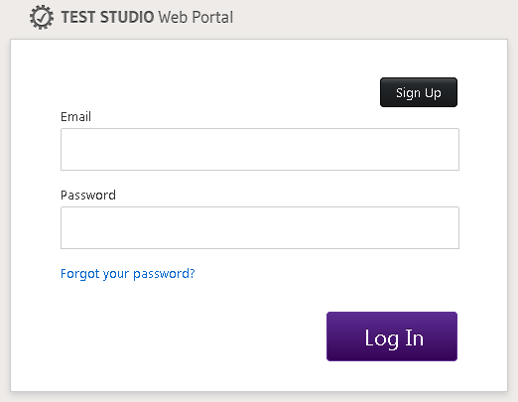
Test Studio Web Portal
Dashboard
Feedback
Testing
Crash Reports
Contributors

Slide 14
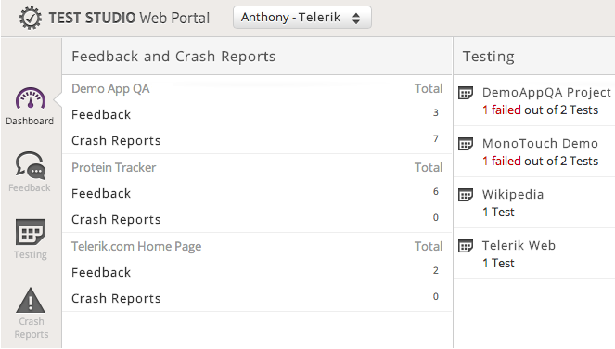
Web Portal Dashboard
The dashboard provides an overview of your account with a quick glimpse into
Feedback
Crash Reporting
Testing activity

Slide 15
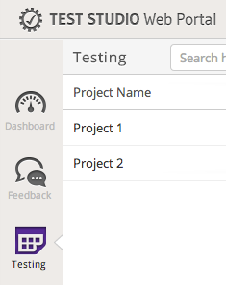
Web Portal Feedback & Testing
Feedback
See what your team, and potentially the public, is saying about your application
Testing
View the collection of projects created and synced between your automation devices

Slide 16
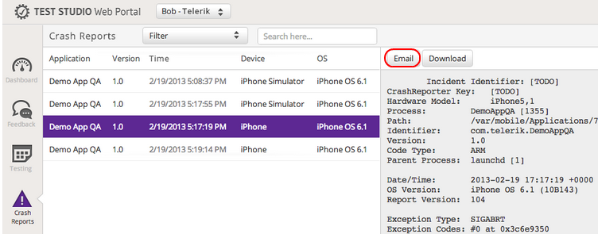
Web Portal Crash Reports
Crash Reports
Receive vital information about when, how, and why your application is crashing Testing
Click Email to sent the error to the developer

Slide 17
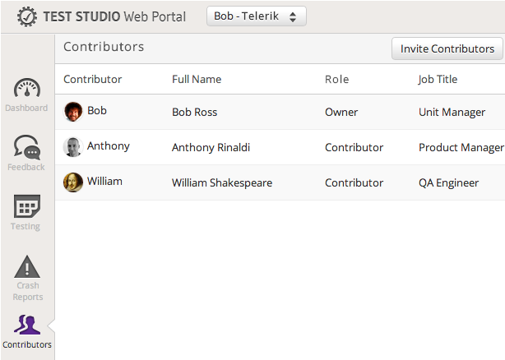
Web Portal Contributors
Contributors
The account owner may invite contributors via email, view sent invites, and delete existing users

Slide 18
TSReport
An iOS reporting library that provides services and tools for reporting feedback and crashes
Setup
UIKit – Objective-C
Xamarin.iOS – C#
Cordova – HTML, JavaScript & CSS

Slide 19
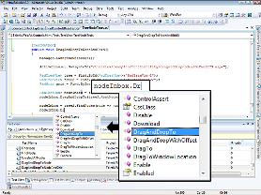
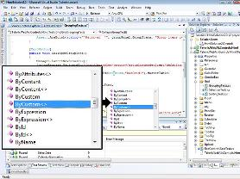
Telerik Testing Framework

Slide 20
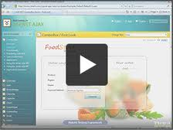
Telerik Testing Framework
Telerik offers a free testing framework
Formerly known as WebAii Testing Framework
Telerik Testing Framework can be downloaded from Telerik's web site: http://www.telerik.com/automated-testing-tools/webaii-framework-features.aspx

Slide 21
Telerik Testing Framework Functionality
Telerik Testing Framework provides various functionality
Browser abstraction
Telerik RadControls Automation
Subscribe to JavaScript Events
Extensive HtmlControl Suite
AJAX Automation
Element Identification Using LINQ

Slide 22
Telerik Testing Framework Functionality (2)
Telerik Testing Framework provides various functionality
Silverlight Automation
JavaScript Invocation and Logging
VS Unit Testing Integration
HtmlPopups and Browser Dialogs Support
NUnit/MbUnit/XUnit Integration

Slide 23
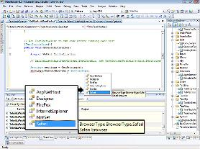

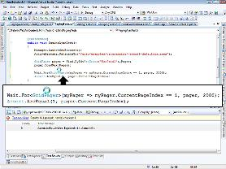
Telerik Testing Framework
Quick Demo
Source: http://simpleprogrammer.com

Slide 24




Test Studio’s Extras
Integration and Bug tracking

Slide 25
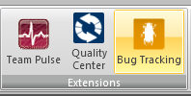
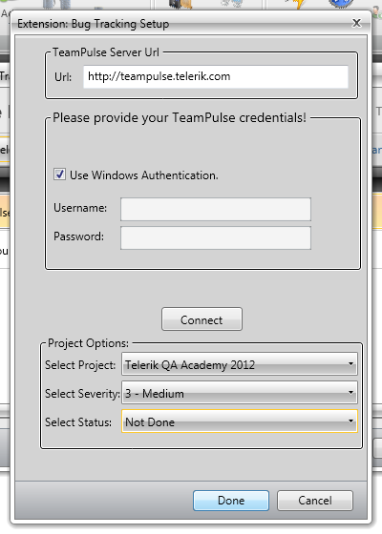
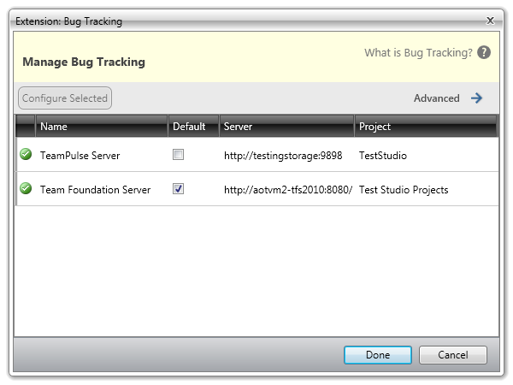
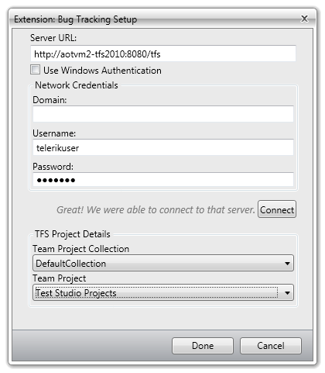
Bug Tracking
Test Studio’s Bug tracking
Log bugs directly from Test Studio into defect tracking systems
Team Pulse
Team Foundation Server

Slide 26
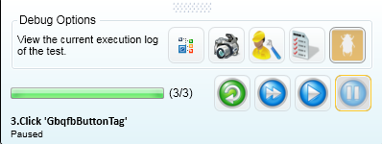
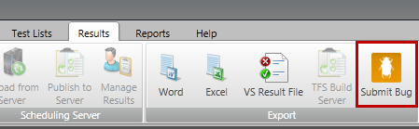
How To Submit Bugs
Four ways to submit a bug
Right click on the failed step and then
Double click on the icon in front of the failed step and then on the Step Failure Details click
Pause the Visual Debugger and click
From the Results Tab

Slide 27
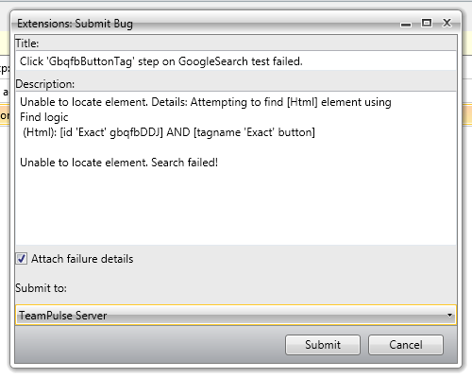
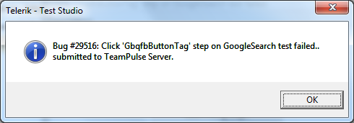
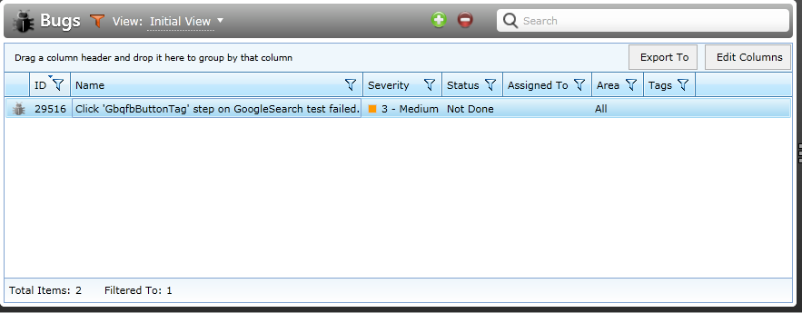
How To Submit Bugs (2)
Fill in Title and Description
Select the server you want to submit to
Click Submit

Slide 28
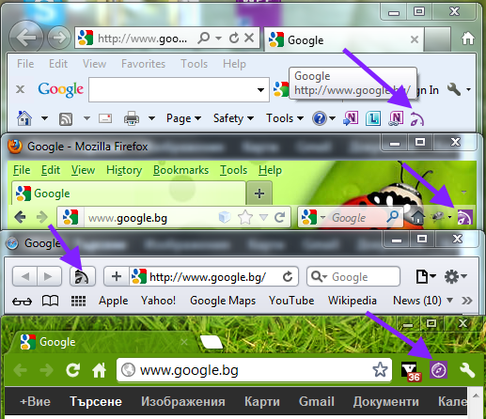

Test Studio Explore
Test Studio Explore
easily capture bugs and send feedback
available in Internet Explorer, Firefox, Safari, and Chrome
Close
Move
Feedback - provide comments on a web page and submit your assessment.
Help

Slide 29
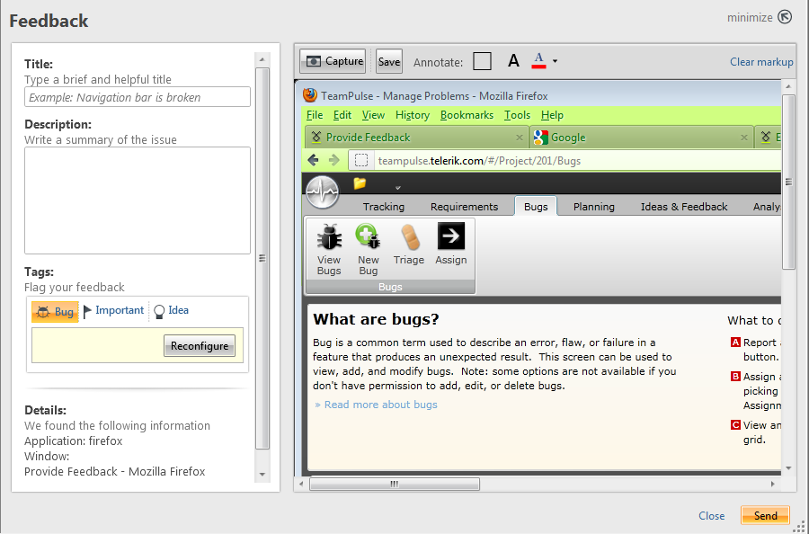
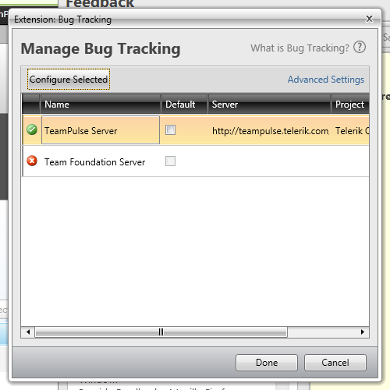
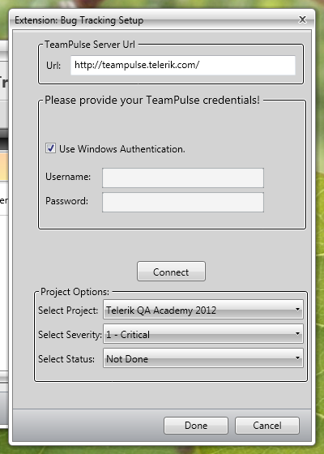
How To Send Feedback
Capture your screenshot
Configure your server, user credentials and project options (TFS or TeamPulse)

Slide 30
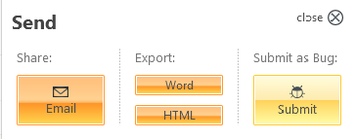
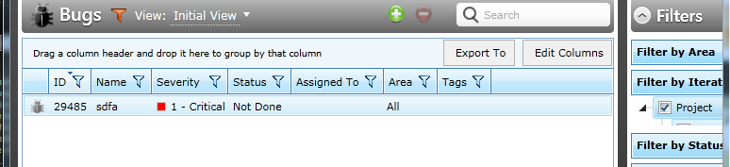
How To Send Feedback(2)
Send your feedback
Via e-mail
to your bug tracking tool
Export it as document
Observe the results

Slide 31
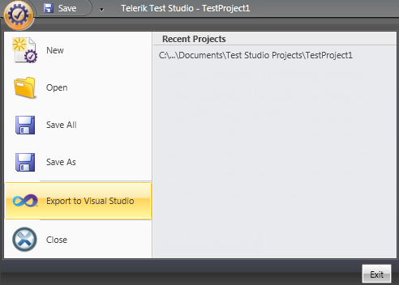
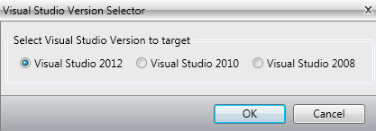
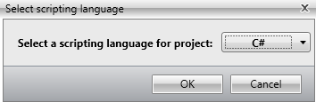
Export to Visual Studio
You can export your test project from the Standalone version to Visual Studio for direct use

Slide 32
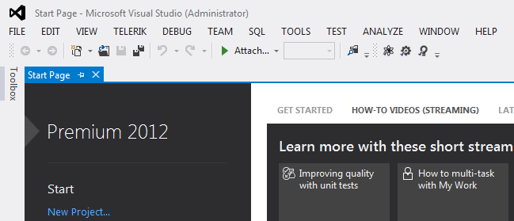
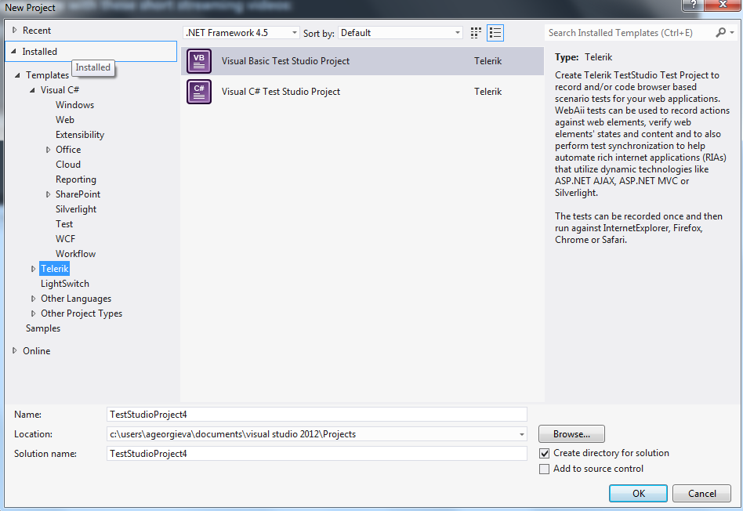
Visual Studio Plug in
Create Test Studio Project in Visual Studio

Slide 33
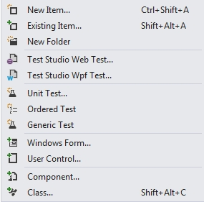
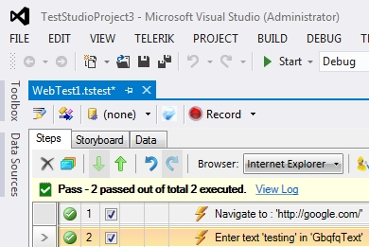
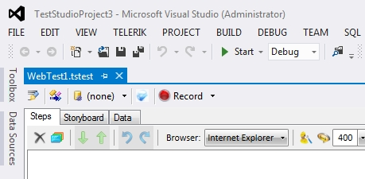
Web Tests
Record web tests
Add new Web Test
Record your Test
Export web tests
Add code behind
http://www.telerik.com/automated-testing-tools/support/documentation/user-guide/create-a-test-vs-plugin/web-test.aspx

Slide 34
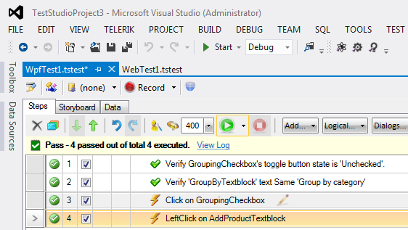
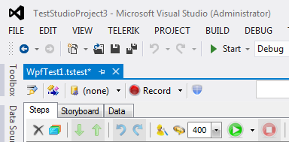
WPF Testing
Record WPF tests
Add new WPF Test
Configure WPF Application Path
Record your test
Export web tests
Add code behind
http://www.telerik.com/automated-testing-tools/support/documentation/user-guide/create-a-test-vs-plugin/wpf-test.aspx

Slide 35
Telerik Test Studio
?
?
?
?
?
Questions?
?
?
?
?
?
?

